Slide 1
Problem Statement
Predict the flight prices using the data of prices of flight tickets for various airlines between the months of March and June of 2019 and between various cities..

Slide 2
Data
The data consist of prices of 8013 flight tickets for various airlines between the months of March and June of 2019 and between various cities.
Features are Airline, Date_of_Journey, Source, Destination, Route , Dep_Time, Arrival_Time, Duration, Total_Stops, Additional_Info, Price

Slide 3
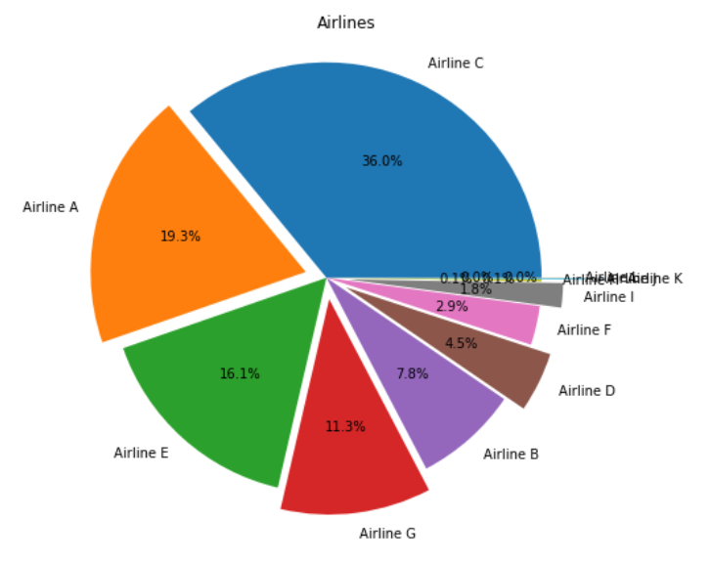
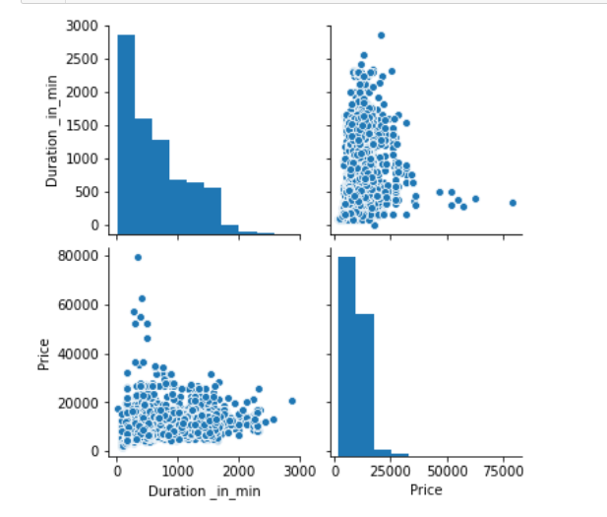
Analysis of Data
The largest number of flight tickets were for airlines C and the smallest number of flight tickets were for airlines K.
The price varies with slight linear correlation with duration in minutes.

Slide 4
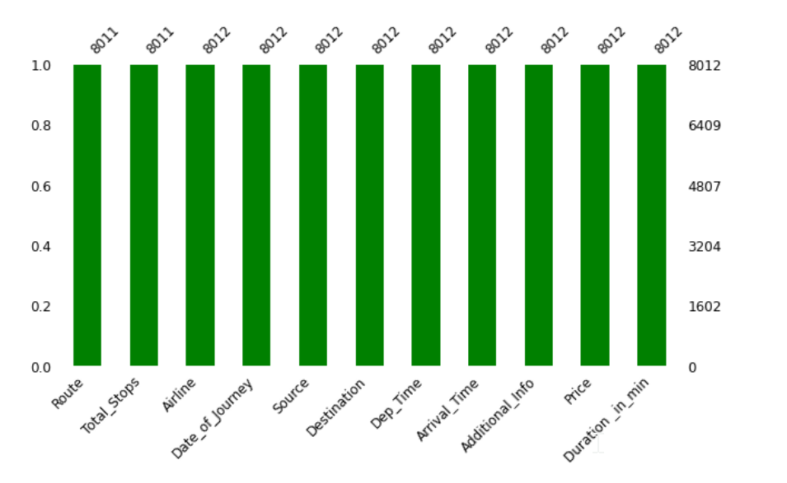
Analysis of Data
There are no missing values in any column except two columns with 1 missing value.

Slide 5
observations
The duration value is in the format of hours and minutes. It is good to convert to only mins so that it is easier to encode.
The price may differ based on whether it is a weekend or a weekday. Therefore, it is good to convert the date of journey to the day of the week. This will help in a better model for flight price prediction.
The Additional column has differing information for some of the flights. And, unless it is parsed using NLP and identified into separate categories, it may not hold value for the machine model. So, it was dropped.

Slide 6
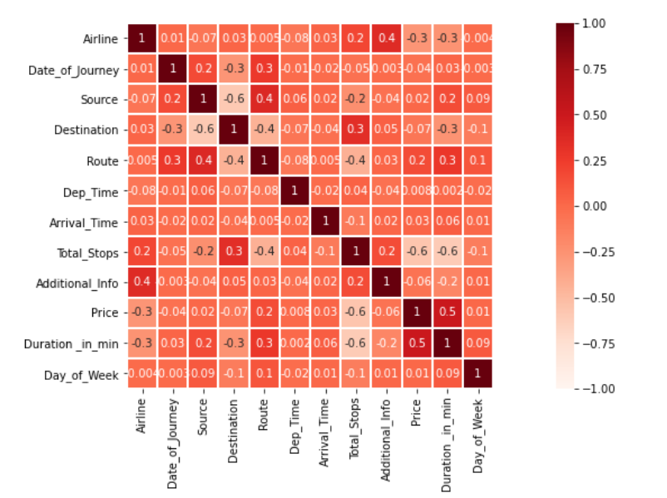
correlation
Based on the heat map we can see that there is high correlation between duration in minutes and price. There is also high negative correlation between no of stops and price.

Slide 7
MACHINE LEARNING MODELS
RMSE between the predicted price(y_pred) and the observed price(y_true) is calculated using the formulae:
-np.sqrt(np.square(np.log10(y_pred +1) - np.log10(y_true +1)).mean())
LINEAR REGRESSION
RMSE: -0.15382690702196586
RANDOM FOREST REGRESSION
RMSE: -0.08553874202794202
ADA BOOST REGRESSOR
RMSE: -0.28852171860706
XGB REGRESSOR
RMSE: -0.0778318696839152

Slide 8
RECOMMENDATIONS
Random Forest algorithm has the lowest RMSE. Therefore, it is recommended to use Random Forest model for training the data in order to predict flight prices.

